Slide 1





Welcome to the
Dad Allies Learning Series
We know that:
Child and family well-being improve when fathers are positively engaged in their children’s lives.
Fathers play a unique and important role in children’s development.
Fathers should have support and resources to become the fathers they aspire to be.
Notes:
Welcome to our 7th monthly Dad Allies Learning Series Session!
My name is
We want to thank our sponsors
I come to you today as a guest of the Nisqually Tribe from their ancestral lands at the bottom of the Salish Sea. These lands have been and still are a traditional gathering place for the Coast Salish people. I recognize that all who are not Salish people are visitors and I commit to join to share their history, build relationships with our tribal partners to restore the settlers damage done to land, sea, and families.
We will be recording this session so you can share, please monitor accordingly
Introduce self and your relationship to fathering in the chat
Introduce speaker

Slide 2

Effectively Engaging Fathers in Home Visiting Services to Support the Entire Family
Dad Allies Provider Learning Series Session
February 16, 2023

Slide 3

Agenda
Introduction and Welcome
Overview
Facilitated Conversation with Home Visiting Pairs
Q&A

Slide 4
Definition of Home Visiting
“Home visiting programs are voluntary, family-focused services offered to expectant parents and families with new babies and young children to support the physical, social, and emotional health of your child.”
–Washington State Department of Children, Youth, and Families

Slide 5
Why engage fathers in home visiting?
Fathers and family outcomes
Importance of mother-father co-parenting relationship
Growth and reach of home visitation
Improved outcomes with father engagement

Slide 6
Evidence-Supported HV and Fathers
Evidence-supported home visiting programs were initially designed for mothers and babies
Emerging interventions:
  Dads Matter-Home Visiting (Dads Matter-HV)
  Filming Interactions to Nurture Development (FIND-F)
  Tennessee Dad Project
Notes:
Bellamy, J. L., Banman, A., Harty, J. S., Mirque-Morales, S., Jaccard, J., & Guterman, N. B. (2023). The Effect of Dads Matter–HV on Father Engagement in Home Visiting Services. Prevention Science, 24(1), 137-149.
Guterman, N. B., Bellamy, J. L., & Banman, A. (2018). Promoting father involvement in early home visiting services for vulnerable families: Findings from a pilot study of “Dads matter”. Child abuse & neglect, 76, 261-272.
Schindler, H. S., Fisher, P. A., & Shonkoff, J. P. (2017). From innovation to impact at scale: Lessons learned from a cluster of research–community partnerships. Child Development, 88(5), 1435-1446.
Stolz, H. E., LaGraff, M. R., Mullican, K. N., Connor, L. A., Green, M. J., & Clouthier, S. (2020). Exploring fathers’ engagement with home visiting: The Tennessee dad project. Families in Society, 101(4), 498-513.

Slide 7

Survey of Home Visitors
Workers espouse generally positive attitudes and expectations about working with fathers and mothers together in home visiting, and yet rates of father engagement are low and inconsistent.
Notes:
Bellamy, J.L., Harty, J., Guterman, N., Banman, A., Morales-Mirque, S. & Massey Combs, K. (2020). The Engagement of Fathers in Home Visiting Services: Learning from the Dads Matter-HV Study, Fatherhood Research and Practice Network Report, (https://www.frpn.org/asset/frpn-grantee-report-the-engagement-fathers-in-home-visiting-services-learning-the-dads-matter).

Slide 8
Survey of Home Visitors
Home visitors say that:
      Lack of time
      Perception that fathers do not want to participate
      Lack of training
      Worry that if they work with fathers, it will take away from their work with mothers
      ….Prevents them from engaging fathers.
Notes:
Bellamy, J.L., Harty, J., Guterman, N., Banman, A., Morales-Mirque, S. & Massey Combs, K. (2020). The Engagement of Fathers in Home Visiting Services: Learning from the Dads Matter-HV Study, Fatherhood Research and Practice Network Report, (https://www.frpn.org/asset/frpn-grantee-report-the-engagement-fathers-in-home-visiting-services-learning-the-dads-matter).

Slide 9

Results from a Recent Scoping Review
No clear/consistent evidence on how fathers’ or home visitors’ characteristics relate to engagement in home visiting services
Fathers' perception of their role in the family and services relates to their engagement
Purposeful inclusion of fathers matters
The relationship quality between the home visitor and father is important
Relatively simple strategies work
Notes:
Burcher, S. A., Corey, L. A., Mentzer, K. M., Davis, L., McNamee, H., Horning, M. L., ... & Shlafer, R. J. (2021). Family home visiting and fathers: A scoping review. Children and youth services review, 128, 106132.

Slide 10
HOME VISITING FATHER ENGAGEMENT STRATEGIES
Talk to him
Make eye contact
Leave things for him
Communicate through Mom
Specifically/explicitly invite him
Tell him he’s needed/important
Referrals (jobs etc.)
Using hands-on activities
Use technology
Being there/consistent/building trust
Giving him information
Providing opportunities to interact with other dads
Explaining benefits of his involvement
Using “other” activities: holiday parties, family events, etc.
Respect/acknowledge his expertise
Consider schedules
Notes:
Bellamy, J. L., Phillips*, J. D., Speer*, S. R., Harty*, J. S., Banman*, A., Guterman, N. B. & Morales-Mirque, S. (In Press). Strategies to enhance father engagement in home visiting: Results from a qualitative study of Dads Matter-HV. Journal of the Society for Social Work and Research.

Slide 11
Engaging Fathers Nationally:
A Missed Opportunity
Nearly 90% of children in EHS home visiting programs have at least one father or father figure involved in their lives.
Yet…EHS home visitors reported that only 20% of families they served had a father participate in a recent home visit.
(Early Head Start; Schindler & Granda, 2023)

Slide 12
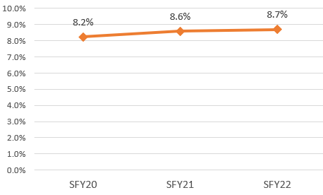
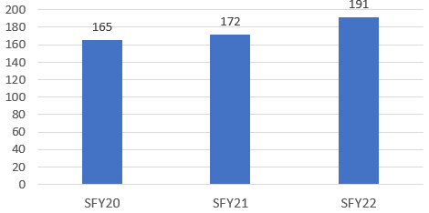
Number of male caregivers served by HVSA has increased in recent years.
Number of male caregivers served as enrolled participants, All HVSA, SFY20-SFY22
% of male caregivers served as enrolled participants, All HVSA, SFY20-SFY22
Notes:
Data shows that the number of caregivers served by the HVSA has increased in recent years. This data is put together by the DOH team.
Graph on the left:
In SFY20, HVSA program served 165 male caregivers as enrolled participants while this number went up to 191 male caregivers in SFY22.
Graph on the right:
Proportion of male caregivers among all caregivers enrolled as participants also increased from 8.2% in SFY20 to 8.7% in SFY22.
However, these numbers do not include male caregivers and fathers, who participated in home visiting, but were not program enrollees. Looking at program enrollees gives an undercount in both graphs for possible father/partner participation.

Slide 13
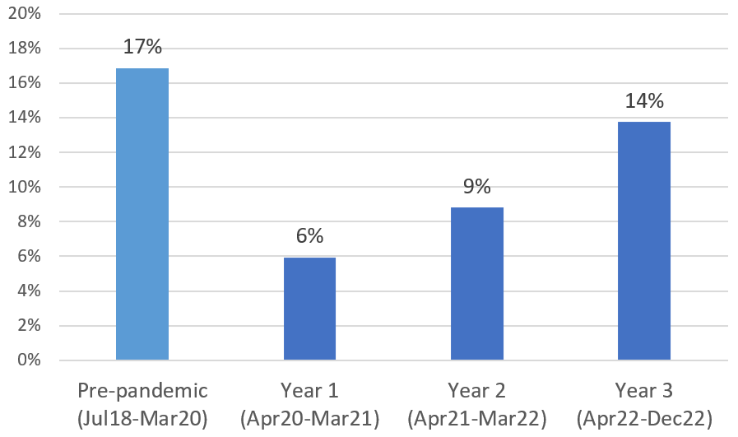
Father/Current Partner Participation in Home Visits, Pre-pandemic to Pandemic Year 3, HVSA NFP Programs
Father/partner participation in home visits decreased during the pandemic, which mirrored an increase in phone visits.
Father/partner participation is now approaching pre-pandemic level.
Notes:
For example, NFP program only enrolls pregnant and birthing parents as participants. But NFP programs involve fathers and partners during home visits.
(Note. This analysis was done by Brynn, and this was presented during HVAC.)
This graph shows father and current partner participation in home visits by NFP programs funded by the HVSA.
During the pre-pandemic period, fathers/current partners participated in about 17% of home visits.
During the pandemic, father/current partner participation decreased, which mirrored an increase in phone visits.
As we come out of the pandemic, father/partner participation has increased to 14% of home visits, approaching pre-pandemic level.

Slide 14

Facilitated Conversation with Home Visiting Pairs

Slide 15

Question and Answer

